Slide 1
Predicting health metrics OF a region : A big data approach
Submitted to: SUBMITTED BY:
Dr. WEIDER YU Amreen ABDUL WAHAB
DISHANT KIMTANI
RIMPY BHAROT
SIDDHARTH SUTHAR

Slide 2
What do we want to achieve?
Suppose a person needs ( or wants ) to move to a new city or town.
How suitable will that place be for that person health wise?
Will he/she be suffering from more ailments or will it be better for his/her health?
What proactive measures can they take to avoid ailments?

Slide 3
Problem statement
Can we measure the suitability of a city or a town for a person's health?
What determines the well being and good health of the people in that region?
Can a definitive metric be provided for particular or all ailments of a region?

Slide 4
solution
A person should be able to query our application by selecting their ailments and then the region of interest.
The application should give a scale of 'risk' for each selected ailment in a graphical format.
It should also provide list of all ailments of that region ordered from high risk to low risk

Slide 5
5 v's of big data in healthcare
VOLUME: The data is collected by a large number of sources for a very large number of subjects. This data is growing exponentially and doubles each year.
VELOCITY: Data from sources like Facebook, Twitter are updated real time. Also the hospital, claims or pharmacy data is updated with every new patient or customer.
VARIETY: Different data sources produce data of different format and structures. Medical records vary in formats and type.
VERACITY: Data from social media may not be trustworthy but it is important that accuracy is maintained in the records provided by government or hospitals or other authorized sources.
VALUE: Helps in predicting suitability of area.

Slide 6
FINAL SCORE for that region
Each ailment can be provided a weight according to its severity for that person.
A final score based on the severity of those ailments in the selected region will be calculated
This will help the end user to decide whether the region is suitable for their health or not.

Slide 7
Role of big data
By digitizing, combining and effectively using big data, healthcare organizations ranging from single-physician offices and multi-provider groups to large hospital networks and accountable care organizations stand to realize significant benefits.[1]
We can leverage patient history data acquired from hospitals and health claims from insurance companies to determine the severity of various diseases in a region.
Notes:
[1] Burghard C: Big Data and Analytics Key to Accountable Care Success. 2012, IDC Health Insights

Slide 8
Data sources
Web and social media data like Facebook, Twitter, LinkedIn, blogs, health plan websites, smartphone apps etc. (unstructured). [2]
Data provided by hospitals giving various outbreaks, number of cases of each type of diseases, most common symptoms etc. (structured or unstructured depending upon willingness of hospital)
Health care claims and other billing records. (semi-structured and unstructured formats)[2]
Drug sale data from various pharmacies (structured data).
Govt provided health related data sets like data.hrsa.gov, healthdata.gov etc. (structured)
Notes:
[2] IHTT: Transforming Health Care through Big Data Strategies for leveraging big data in the health care industry. 2013,http://ihealthtran.com/wordpress/2013/03/iht%C2%B2-releases-big-data-research-report-download-today/,

Slide 9
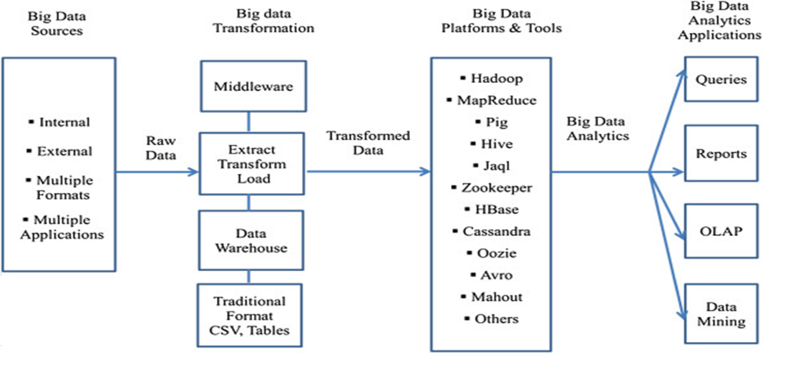
CONCEPTUAL ARCHITECTURE OF BIG DATA ANALYTICS

Slide 10






TECHNOLOGIES TO BE USED

Slide 11
THANK YOU!

